Slide 1


Welcome to the Association for Pathology Informatics Introduction to R Workshop
Class will begin promptly at 1 pm eastern time

Slide 2
Welcome to the Association for Pathology Informatics Introduction to R Workshop
Please open up your browser to Rstudio.Cloud

Slide 3
Welcome to the Association for Pathology Informatics Introduction to R Workshop
All workshop materials are available for download at
tinyurl.com/rapi2020

Slide 4
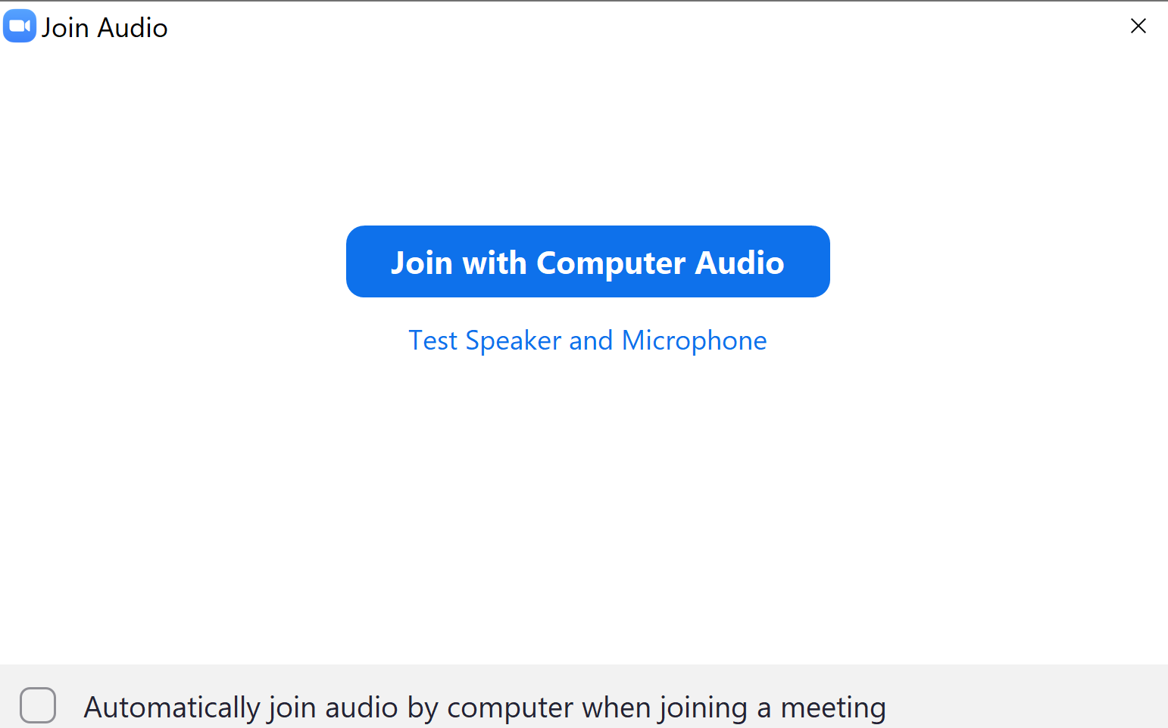
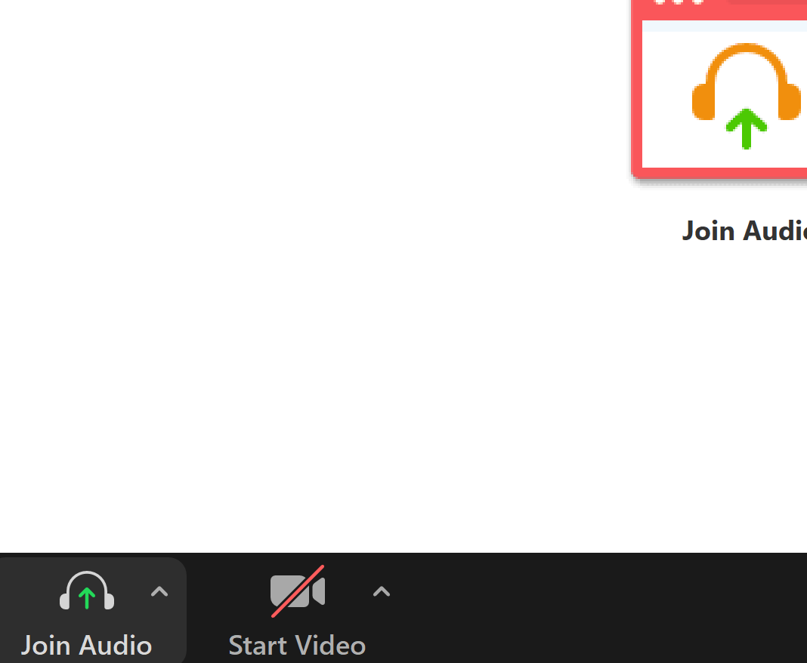
Welcome to the Association for Pathology Informatics Introduction to R Workshop
Have you tested your Zoom audio?

Slide 5
Welcome to the Association for Pathology Informatics Introduction to R Workshop
Please have the PDF coursebook available to follow along with the lectures
The coursebook can be found at tinyurl.com/rapi2020

Slide 6
Welcome to the Association for Pathology Informatics Introduction to R Workshop
Please connect to audio with either your computer or phone – not both, to prevent echoing

Slide 7
Welcome to the Association for Pathology Informatics Introduction to R Workshop
Please remain muted while in the main workshop

